Slide 1
Fundamentals of AC Circuits
Module 2: Fundamentals of AC Circuits

Slide 2




overview
$\text{v}\text{(}\text{t}\text{) = }V_{m} \text{sin}\text{(}ω\text{t} \text{−} θ\text{)}$
$f=\frac{1}{T}$
$ω=2πf$
$V_{rms}=\sqrt{\frac{1}{T}\int_{0}^{T}{v^{2}(t) dt}}$
$P_{avg}=\frac{V_{rms}^{2}}{R}$
$I_{rms}=\sqrt{\frac{1}{T}\int_{0}^{T}{i^{2}(t) dt}}$
$P_{avg}=I_{rms}^{2}R$
$V_{rms}=\frac{V_{m}}{\sqrt{2}}$
$I_{rms}=\frac{I_{m}}{\sqrt{2}}$

Slide 3

overview
$v_{1}=v_{m1}\cos\left(ωt+θ_{1}\right)$
$v_{1}=v_{m1}∠θ_{1}$
$v_{2}=v_{m2}\sin\left(ωt+θ_{2}\right)$
$v_{2}=v_{m2}∠θ_{2}−90$
$i_{1}=i_{m1}\cos\left(ωt+θ_{1}\right)$
$i_{1}=i_{m1}∠θ_{1}$
$i_{2}=i_{m2}\sin\left(ωt+θ_{2}\right)$
$i_{2}=i_{m2}∠θ_{2}−90$
$V=v∠θ$ → V=v(cos($θ$)+j sin($θ$))
v = a + jb → $\sqrt{a^{2}+b^{2}}$ $∠\tan^{−1}\left(b/a\right)$

Slide 4
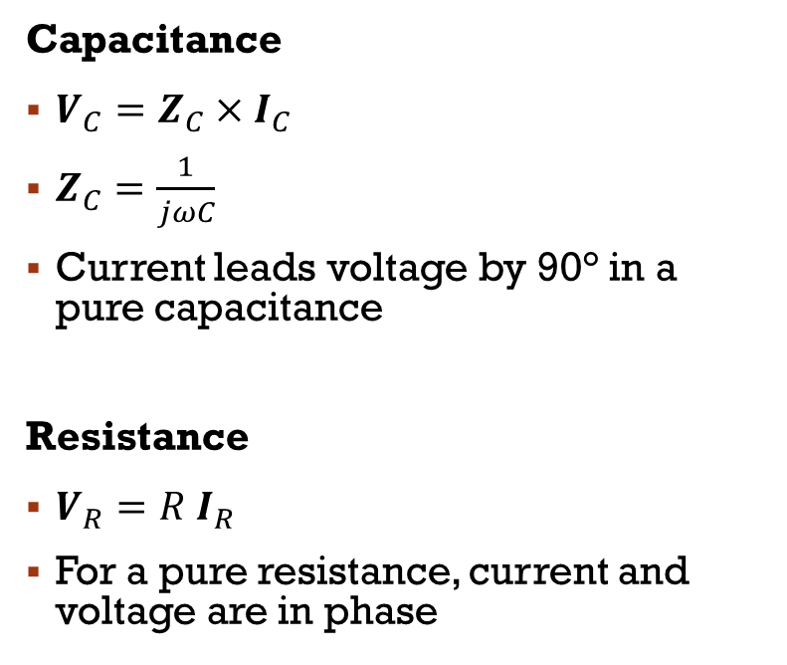
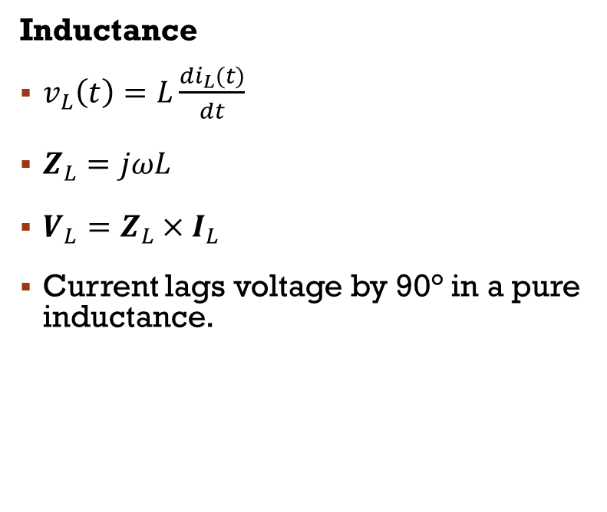
Overview
Capacitance
$V_{C}={Z_{C}×I}_{C}$
$Z_{C}=\frac{1}{jωC}$
Current leads voltage by 90° in a pure capacitance
Resistance
$V_{R}=R I_{R}$
For a pure resistance, current and voltage are in phase
Inductance
$v_{L}\left(t\right)=L\frac{{di}_{L}(t)}{dt}$
$Z_{L}=jωL$
$V_{L}={Z_{L}×I}_{L}$
Current lags voltage by 90° in a pure inductance.

Slide 5
Circuit Analysis with Phasors And Complex impedances
Kirchhoff’s Laws
Node-Voltage Analysis
Mesh-Current Analysis

Slide 6
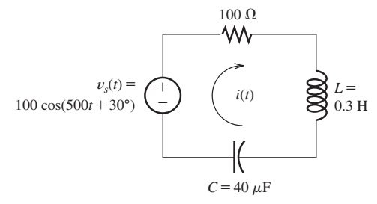
Kirchhoff’s Laws
Steady-State AC Analysis of a Series Circuit
Find the steady-state current for the circuit shown in Figure. Also, find the phasor voltage across each element

Slide 7
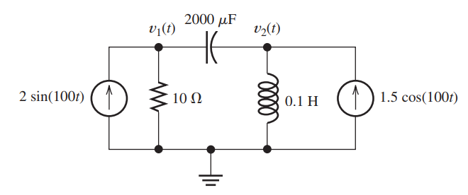
Node-voltage analysis
Use the node-voltage technique to find v1(t) and v2(t) in steady state for the circuit shown in Figure

Slide 8
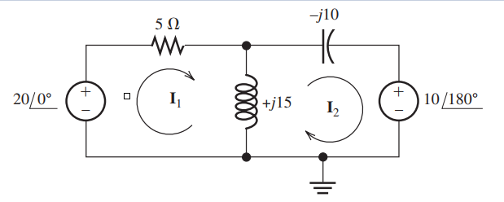
Mesh-current analysis
Solve for the mesh currents I1 and I2

Slide 9
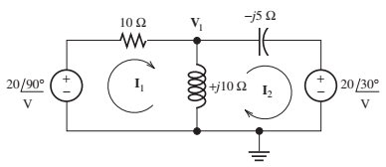
Assignment 1
Find Mesh Currents I1 and I2

Slide 10
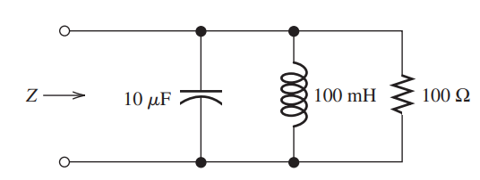
Assignment 2
Compute the complex impedance of the network shown in Figure for ω = 500. Repeat for ω = 1000 and ω = 2000. Give the answers in both polar and rectangular forms

Slide 11

Ac POWER calculations

Slide 12

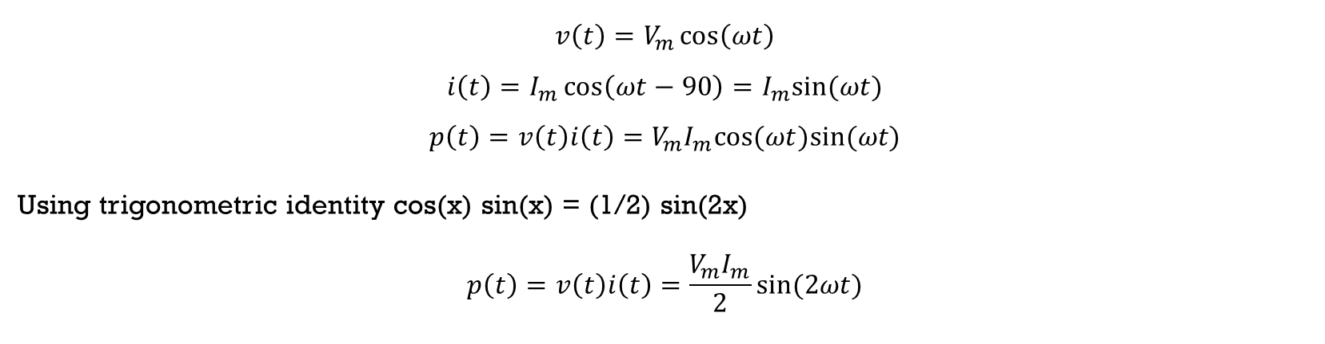
Current, Voltage, and Power for a Resistive Load
$$v\left(t\right)=V_{m}\cos\left(ωt\right)$$
$$i\left(t\right)=I_{m}cos⁡(ωt)$$
$$p\left(t\right)=v\left(t\right)i\left(t\right)=V_{m}I_{m}\cos^{2}⁡(ωt)$$
Current, Voltage, and Power for a Inductive Load
$$v\left(t\right)=V_{m}\cos\left(ωt\right)$$
$$i\left(t\right)=I_{m}\cos\left(ωt−90\right)=I_{m}sin⁡(ωt)$$
$$p\left(t\right)=v\left(t\right)i\left(t\right)=V_{m}I_{m}cos(ωt)sin⁡(ωt)$$
Using trigonometric identity cos(x) sin(x) = (1/2) sin(2x)
$$p\left(t\right)=v\left(t\right)i\left(t\right)=\frac{V_{m}I_{m}}{2}sin⁡(2ωt)$$

Slide 13

Current, Voltage, and Power for a Capacitive Load
$$v\left(t\right)=V_{m}\cos\left(ωt\right)$$
$$i\left(t\right)=I_{m}\cos\left(ωt+90\right)=−I_{m}sin⁡(ωt)$$
$$p\left(t\right)=v\left(t\right)i\left(t\right)=−V_{m}I_{m}cos(ωt)sin⁡(ωt)$$
Using trigonometric identity cos(x) sin(x) = (1/2) sin(2x)
$$p\left(t\right)=v\left(t\right)i\left(t\right)=−\frac{V_{m}I_{m}}{2}sin⁡(2ωt)$$

Slide 14
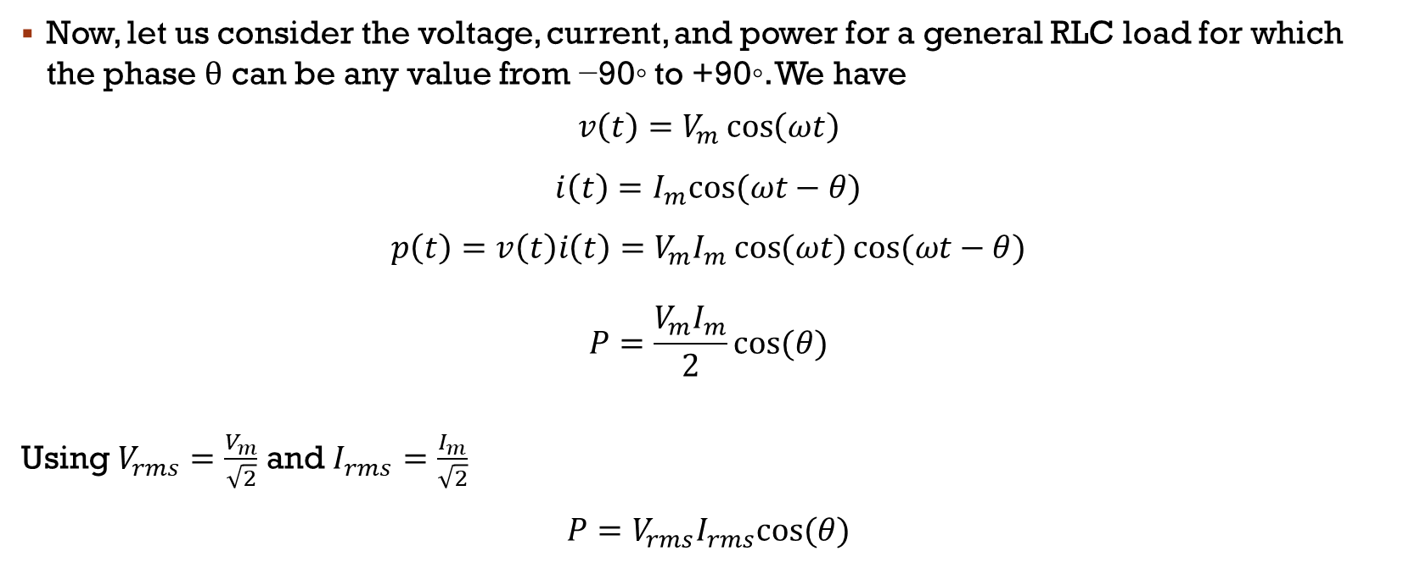
Power Calculations for a General Load
Now, let us consider the voltage, current, and power for a general RLC load for which the phase θ can be any value from −90◦ to +90◦. We have
$$v\left(t\right)=V_{m}\cos\left(ωt\right)$$
$$i\left(t\right)=I_{m}cos⁡(ωt−θ)$$
$$p\left(t\right)=v\left(t\right)i\left(t\right)=V_{m}I_{m}⁡\cos{(ωt)}cos⁡(ωt−θ)$$
$$P=\frac{V_{m}I_{m}}{2}cos⁡(θ)$$
Using $V_{rms}=\frac{V_{m}}{\sqrt{2}}$ and $I_{rms}=\frac{I_{m}}{\sqrt{2}}$ $$P=V_{rms}I_{rms}cos⁡(θ)$$
Active Power & Units (W)

Slide 15
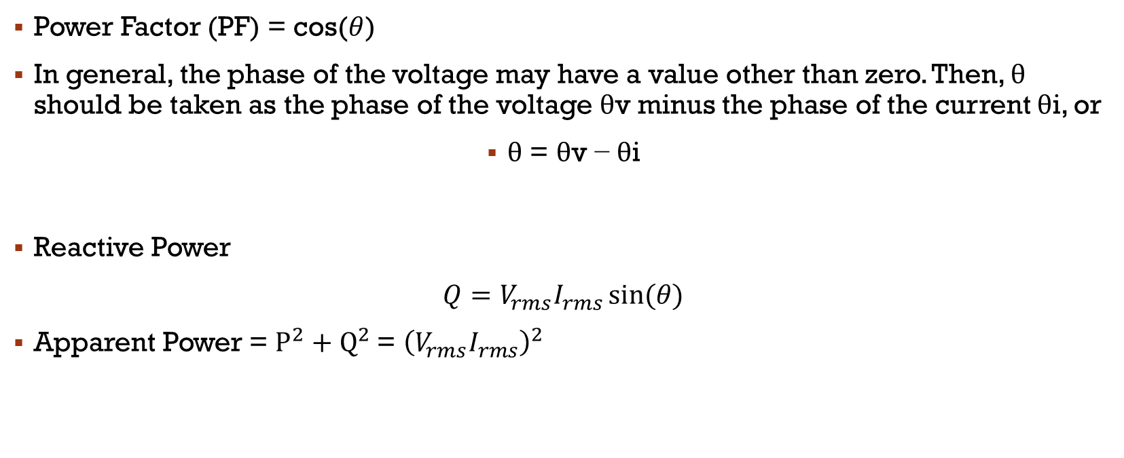
Power Factor & reactive power
Power Factor (PF) = cos($θ$)
In general, the phase of the voltage may have a value other than zero. Then, θ should be taken as the phase of the voltage θv minus the phase of the current θi, or
θ = θv − θi
Reactive Power
$Q=V_{rms}I_{rms}⁡sin(θ)$
Apparent Power = $P^{2}+Q^{2}$= ${\left(V_{rms}I_{rms}\right)}^{2}$

Slide 16
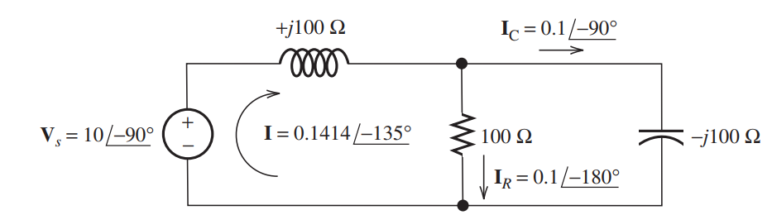
Ac power calculations
Compute the power, reactive power and apparent power taken from the source for the circuit

